Slide 1
Convolutional Neural Networks

Slide 2
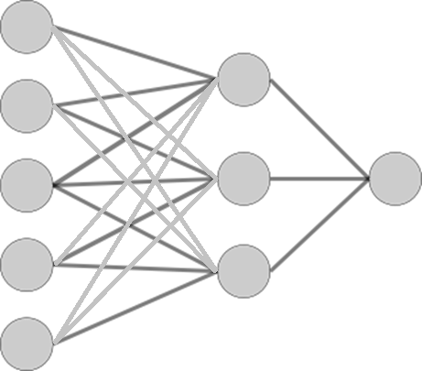
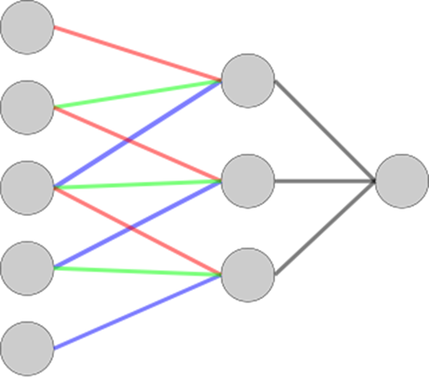
Convolutional Neural Networks
Reduction of Model Complexity
Partially connected & shared weights
Convolutional Neural Network (CNN)
Specialized to sequential data
Images, Speech, Text

Slide 3
Image Classification
X, O Classification
Classifier
X or O
A two-dimensional
array of pixels

Slide 4
Image Classification
translation
Classifier
X
scaling
rotation
weight
Classifier
O

Slide 5
Image Classification
Same?
How to determine both are the same?
=

Slide 6
Image Classification
Both are partially matching
Critical LOCAL features are the same
=
=
=

Slide 7
Image Classification
Local Features
How about finding local features, and
Matching them

Slide 8

Feature Extraction
Convolution
A way to find out local features
1 | 0 | 1
0 | 1 | 1
1 | 1 | 0
1 | 0 | 1
0 | 1 | 0
1 | 0 | 1
*
= 3
$$I∗K=\sum{K_{ij}×I_{ij}}$$

Slide 9
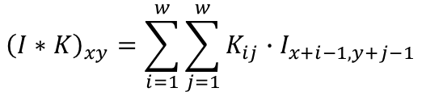
Feature Extraction
Convolution
-1 | -1 | 1
-1 | 1 | -1
1 | -1 | -1
$${\left(I∗K\right)}_{xy}=\sum_{i=1}^{w}{\sum_{j=1}^{w}{K_{ij}∙I_{x+i−1,y+j−1}}}$$
0 | 0 | 0 | 0 | 0 | 0 | 0 | 0
0 | 0 | 0 | 1 | 1 | 0 | 0 | 0
0 | 0 | 1 | 0 | 1 | 1 | 0 | 0
0 | 1 | 0 | 0 | 0 | 0 | 1 | 0
0 | 1 | 0 | 0 | 0 | 0 | 1 | 0
0 | 0 | 1 | 0 | 1 | 1 | 0 | 0
0 | 0 | 0 | 1 | 1 | 0 | 0 | 0
0 | 0 | 0 | 0 | 0 | 0 | 0 | 0
 | -1

Slide 10
Feature Extraction
Convolution
-1 | -1 | 1
-1 | 1 | -1
1 | -1 | -1
$${\left(I∗K\right)}_{xy}=\sum_{i=1}^{w}{\sum_{j=1}^{w}{K_{ij}∙I_{x+i−1,y+j−1}}}$$
0 | 0 | 0 | 0 | 0 | 0 | 0 | 0
0 | 0 | 0 | 1 | 1 | 0 | 0 | 0
0 | 0 | 1 | 0 | 1 | 1 | 0 | 0
0 | 1 | 0 | 0 | 0 | 0 | 1 | 0
0 | 1 | 0 | 0 | 0 | 0 | 1 | 0
0 | 0 | 1 | 0 | 1 | 1 | 0 | 0
0 | 0 | 0 | 1 | 1 | 0 | 0 | 0
0 | 0 | 0 | 0 | 0 | 0 | 0 | 0
 | -1
 | -2

Slide 11
Feature Extraction
Convolution
-1 | -1 | 1
-1 | 1 | -1
1 | -1 | -1
$${\left(I∗K\right)}_{xy}=\sum_{i=1}^{w}{\sum_{j=1}^{w}{K_{ij}∙I_{x+i−1,y+j−1}}}$$
0 | 0 | 0 | 0 | 0 | 0 | 0 | 0
0 | 0 | 0 | 1 | 1 | 0 | 0 | 0
0 | 0 | 1 | 0 | 1 | 1 | 0 | 0
0 | 1 | 0 | 0 | 0 | 0 | 1 | 0
0 | 1 | 0 | 0 | 0 | 0 | 1 | 0
0 | 0 | 1 | 0 | 1 | 1 | 0 | 0
0 | 0 | 0 | 1 | 1 | 0 | 0 | 0
0 | 0 | 0 | 0 | 0 | 0 | 0 | 0
 | -1
 | -2
 | 1

Slide 12
Feature Extraction
Convolution
-1 | -1 | 1
-1 | 1 | -1
1 | -1 | -1
$${\left(I∗K\right)}_{xy}=\sum_{i=1}^{w}{\sum_{j=1}^{w}{K_{ij}∙I_{x+i−1,y+j−1}}}$$
0 | 0 | 0 | 0 | 0 | 0 | 0 | 0
0 | 0 | 0 | 1 | 1 | 0 | 0 | 0
0 | 0 | 1 | 0 | 1 | 1 | 0 | 0
0 | 1 | 0 | 0 | 0 | 0 | 1 | 0
0 | 1 | 0 | 0 | 0 | 0 | 1 | 0
0 | 0 | 1 | 0 | 1 | 1 | 0 | 0
0 | 0 | 0 | 1 | 1 | 0 | 0 | 0
0 | 0 | 0 | 0 | 0 | 0 | 0 | 0
 | -1 | -2 | 0 | -2 | -1 | 1
 | -2 | 3 | -2 | -2 | -2 | -2
 | 1 | -1 | -2 | 0 | -4 | -1
 | -1 | -3 | 0 | -2 | 0 | 1
 | -2 | -1 | -4 | 0 | 2 | -2
 | 1 | -2 | 0 | 0 | -3 | -1

Slide 13
Feature Extraction
Convolution
-1 | -1 | 1
-1 | 1 | -1
1 | -1 | -1
$${\left(I∗K\right)}_{xy}=\sum_{i=1}^{w}{\sum_{j=1}^{w}{K_{ij}∙I_{x+i−1,y+j−1}}}$$
0 | 0 | 0 | 0 | 0 | 0 | 0 | 0
0 | 0 | 0 | 1 | 1 | 0 | 0 | 0
0 | 0 | 1 | 0 | 1 | 1 | 0 | 0
0 | 1 | 0 | 0 | 0 | 0 | 1 | 0
0 | 1 | 0 | 0 | 0 | 0 | 1 | 0
0 | 0 | 1 | 0 | 1 | 1 | 0 | 0
0 | 0 | 0 | 1 | 1 | 0 | 0 | 0
0 | 0 | 0 | 0 | 0 | 0 | 0 | 0
0 | 0 | -1 | -2 | 0 | 1 | 0 | 0
0 | -1 | -2 | 0 | -2 | -1 | 1 | 0
-1 | -2 | 3 | -2 | -2 | -2 | -2 | 1
-2 | 1 | -1 | -2 | 0 | -4 | -1 | 0
0 | -1 | -3 | 0 | -2 | 0 | 1 | -2
1 | -2 | -1 | -4 | 0 | 2 | -2 | -1
0 | 1 | -2 | 0 | 0 | -3 | -1 | 0
0 | 0 | 1 | 0 | -2 | -1 | 0 | 0

Slide 14
Feature Extraction
Threshold
-1 | -1 | 1
-1 | 1 | -1
1 | -1 | -1
$${\left(I∗K\right)}_{xy}=\sum_{i=1}^{w}{\sum_{j=1}^{w}{K_{ij}∙I_{x+i−1,y+j−1}}}$$
0 | 0 | 0 | 0 | 0 | 0 | 0 | 0
0 | 0 | 0 | 1 | 1 | 0 | 0 | 0
0 | 0 | 1 | 0 | 1 | 1 | 0 | 0
0 | 1 | 0 | 0 | 0 | 0 | 1 | 0
0 | 1 | 0 | 0 | 0 | 0 | 1 | 0
0 | 0 | 1 | 0 | 1 | 1 | 0 | 0
0 | 0 | 0 | 1 | 1 | 0 | 0 | 0
0 | 0 | 0 | 0 | 0 | 0 | 0 | 0
0 | 0 | 0 | 0 | 0 | 1 | 0 | 0
0 | 0 | 0 | 0 | 0 | 0 | 1 | 0
0 | 0 | 3 | 0 | 0 | 0 | 0 | 1
0 | 1 | 0 | 0 | 0 | 0 | 0 | 0
0 | 0 | 0 | 0 | 0 | 0 | 1 | 0
1 | 0 | 0 | 0 | 0 | 2 | 0 | 0
0 | 1 | 0 | 0 | 0 | 0 | 0 | 0
0 | 0 | 1 | 0 | 0 | 0 | 0 | 0

Slide 15
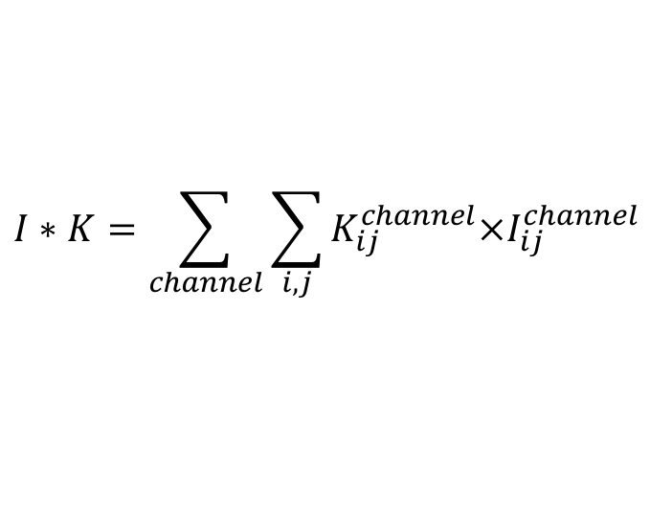
Feature Extraction
Convolution (3D)
0 | 0 | 1
0 | 1 | 0
1 | 0 | 0
-1 | -1 | 1
-1 | 1 | 0
1 | 0 | 0
0 | 0 | 1
0 | 1 | 0
1 | 0 | 0
-1 | -1 | 1
-1 | 1 | 0
1 | 0 | 0
1 | 0 | 1
0 | 0 | 0
1 | 0 | 0
1 | -1 | 1
-1 | 1 | -1
1 | -1 | -1
*
= 2 +3 +4 = 9
$$I∗K=\sum_{channel}{\sum_{i,j}{K_{ij}^{channel}×I_{ij}^{channel}}}$$

Slide 16
Feature Extraction
Convolution (3D)
-1 | -1 | 1
-1 | 1 | 0
1 | 0 | 0
-1 | -1 | 1
-1 | 1 | 0
1 | 0 | 0
-1 | -1 | 1
-1 | 1 | -1
1 | -1 | -1
0 | 1 | 1 | 0 | 0 | 1
0 | 1 | 1 | 1 | 1 | 0
1 | 1 | 0 | 0 | 1 | 1
1 | 1 | 0 | 0 | 1 | 1
0 | 1 | 1 | 1 | 1 | 0
1 | 0 | 1 | 1 | 0 | 0
0 | 0 | 0 | 1 | 1 | 1
0 | 1 | 1 | 1 | 1 | 0
1 | 1 | 0 | 0 | 1 | 1
1 | 1 | 0 | 0 | 1 | 1
1 | 1 | 1 | 1 | 1 | 0
0 | 0 | 1 | 1 | 0 | 0
-1 | 2 | 4 | -2 | -1 | -4
0 | 2 | 5 | 1 | 3 | 2
-2 | 0 | 4 | 2 | -6 | 1
-2 | 1 | 0 | -2 | 3 | -3
1 | 2 | -4 | 4 | 2 | -2
1 | -2 | -4 | 3 | 2 | 1
0 | 0 | 1 | 1 | 0 | 0
0 | 1 | 1 | 1 | 1 | 0
1 | 1 | 0 | 0 | 1 | 1
1 | 1 | 0 | 0 | 1 | 1
0 | 1 | 1 | 1 | 1 | 0
0 | 0 | 1 | 1 | 0 | 0

Slide 17
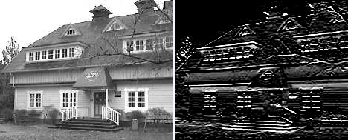
Feature Extraction
Examples of Kernels
1 | 1 | 1
0 | 0 | 0
-1 | -1 | -1
Horizontal Line

Slide 18
Feature Extraction
Pooling
Subsampling from m by m pixels into 1 pixels
Max, averaging or L^{p} pooling
0 | 0 | 0 | 0 | 0 | 1 | 0 | 0
0 | 0 | 0 | 0 | 0 | 0 | 1 | 0
0 | 0 | 3 | 0 | 0 | 0 | 0 | 1
0 | 1 | 0 | 0 | 0 | 0 | 0 | 0
0 | 0 | 0 | 0 | 0 | 0 | 1 | 0
1 | 0 | 0 | 0 | 0 | 2 | 0 | 0
0 | 1 | 0 | 0 | 0 | 0 | 0 | 0
0 | 0 | 1 | 0 | 0 | 0 | 0 | 0
0 | 0 | 1 | 1
1 | 3 | 0 | 1
1 | 0 | 2 | 1
1 | 1 | 0 | 0
Subsampled
feature map
Feature map

Slide 19
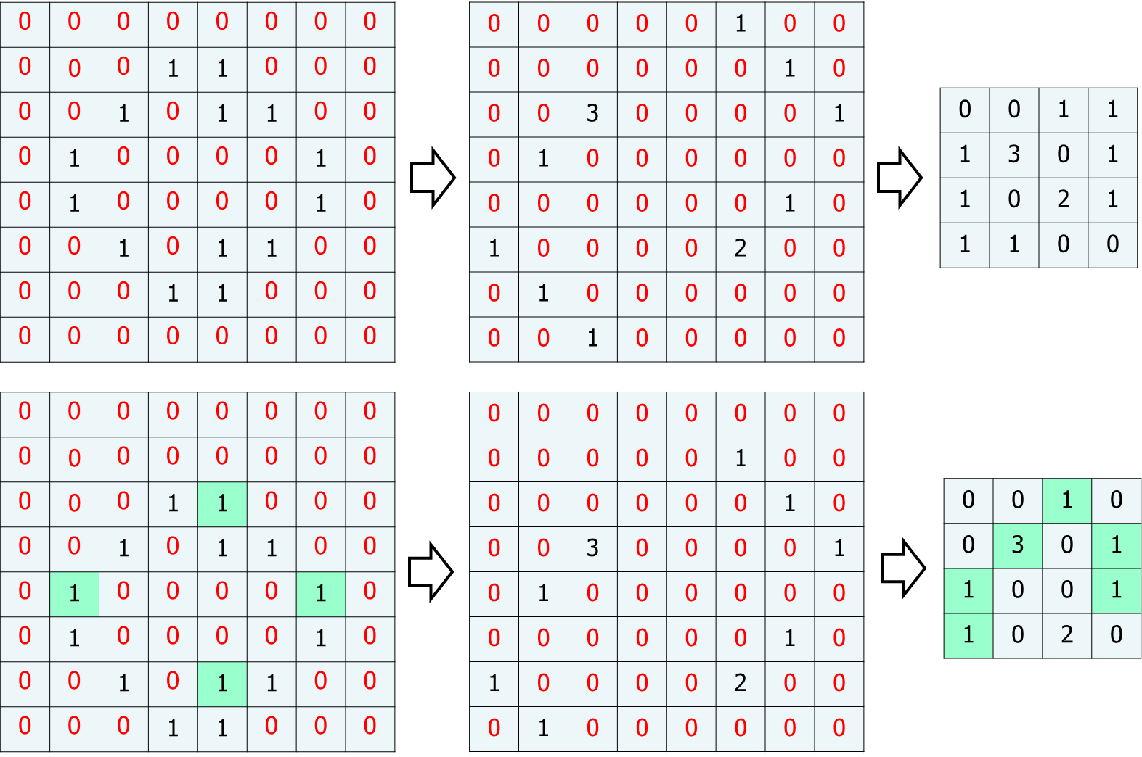
Feature Extraction
Advantage of Pooling
Reducing the number of parameters
Generating more robust feature maps: Shift Invariant
Original
Image
More non-zero values are matched !!
Shifted
Image

Slide 20
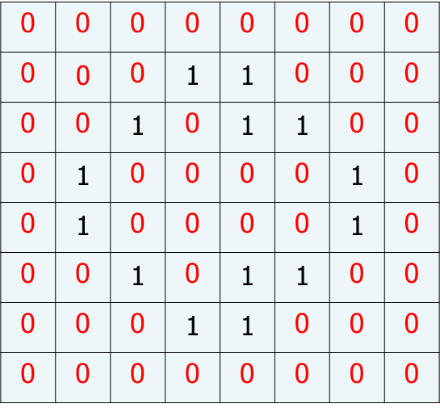
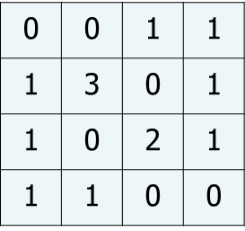
Convolutional Neural Networks
Feature Extraction
Convolution
Threshold
Sub-sampling
Image
Feature map

Slide 21
Convolutional Neural Networks
Feature map is also an image
We can extract many different feature maps
If we can cascade this step many times, we can have a higher feature map
Convolution
Threshold
Sub-sampling
Image
Feature map

Slide 22
Convolutional Neural Networks
Structure
Feature
Map 1
Image
Feature
Map 2
Feature
Map 3

Slide 23
Convolutional Neural Networks
Structure
Higher
Feature
Map 1
Feature
Map 1
Higher
Feature
Map 2
Image
Feature
Map 2
Feature
Map n
Higher
Feature
Map m

Slide 24
Convolutional Neural Networks
Structure
Feature
Map 1
Feature
Map 2
Image
Feature
Map n
Convolution
&
Threshold
Pooling
Convolution
&
Threshold
Pooling
Fully Connected
Layers

Slide 25
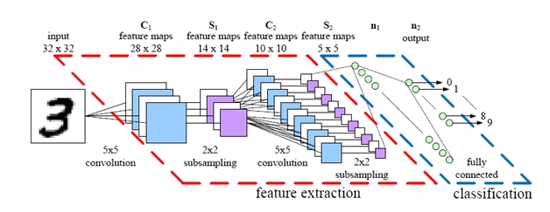
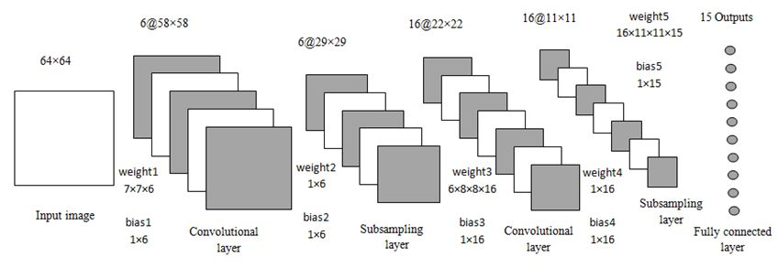
Convolutional Neural Networks
Various Graphical Representation

Slide 26
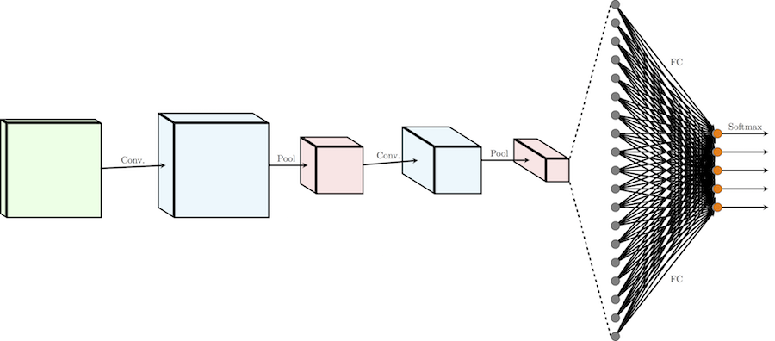
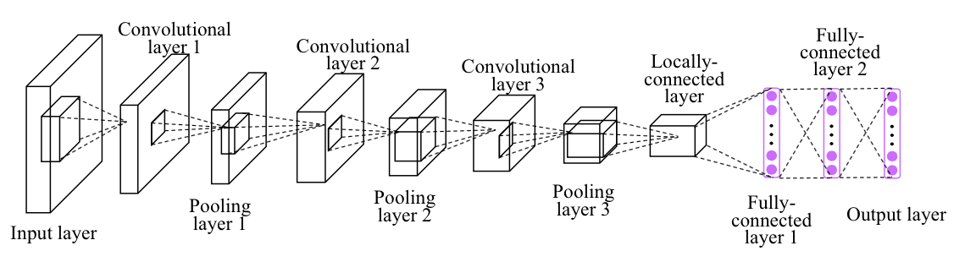
Convolutional Neural Networks
Various Graphical Representation

Slide 27
Convolutional Neural Networks
Who determines convolution masks?
designed by EXPERTS!!
In CNN
CNNs can be converted into neural networks
Convolution masks are converted into connection weights
Masks are found with gradient descent methods

Slide 28
Neural Network Representation
Feature Extraction
Convolution
Threshold
Sub-sampling
Image
Feature map

Slide 29
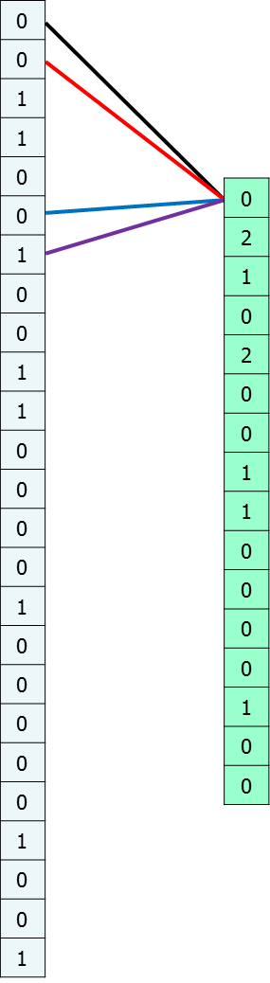
Neural Network Representation
Convolution & Threshold
Values in Kernel => Connection weights
Most of them are zeros
0 | 0 | 1 | 1 | 0
0 | 1 | 0 | 0 | 1
1 | 0 | 0 | 0 | 0
1 | 0 | 0 | 0 | 0
0 | 1 | 0 | 0 | 1
0 | 1
1 | 0
input
Kernel
0 | 2 | 1 | 0
2 | 0 | 0 | 1
1 | 0 | 0 | 0
0 | 1 | 0 | 0
output

Slide 30
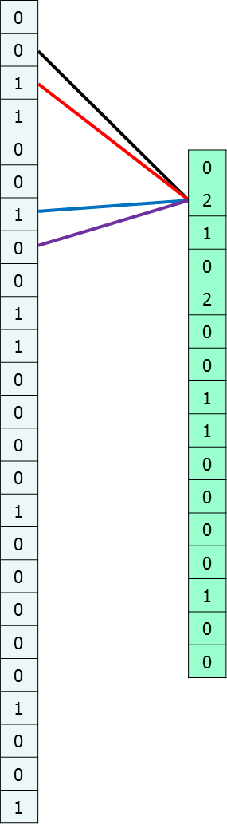
Neural Network Representation
Convolution & Threshold
Values in Kernel => Connection weights
Most of them are zeros
0 | 0 | 1 | 1 | 0
0 | 1 | 0 | 0 | 1
1 | 0 | 0 | 0 | 0
1 | 0 | 0 | 0 | 0
0 | 1 | 0 | 0 | 1
0 | 1
1 | 0
input
Kernel
0 | 2 | 1 | 0
2 | 0 | 0 | 1
1 | 0 | 0 | 0
0 | 1 | 0 | 0
output

Slide 31
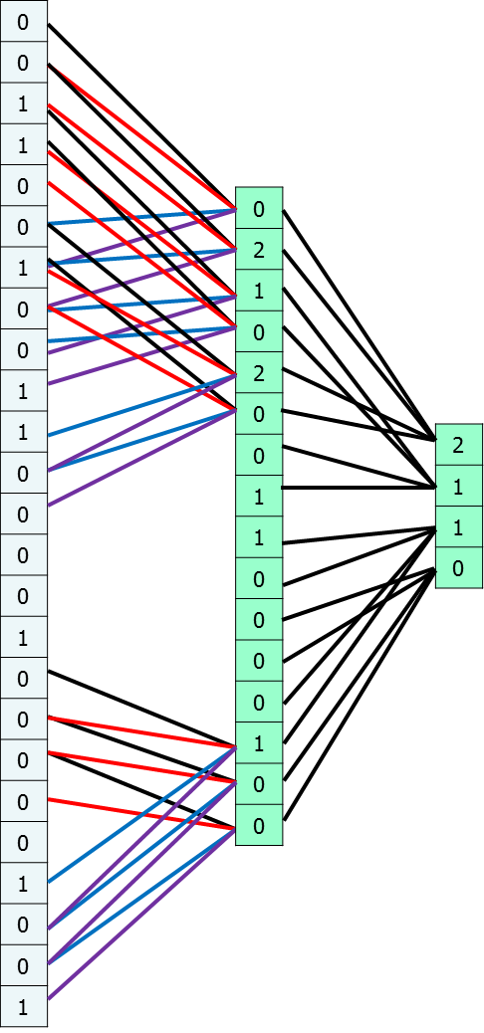
Neural Network Representation
Convolution & Threshold
Values in Kernel => Connection weights
Most of them are zeros
0 | 0 | 1 | 1 | 0
0 | 1 | 0 | 0 | 1
1 | 0 | 0 | 0 | 0
1 | 0 | 0 | 0 | 0
0 | 1 | 0 | 0 | 1
0 | 1
1 | 0
input
Kernel
0 | 2 | 1 | 0
2 | 0 | 0 | 1
1 | 0 | 0 | 0
0 | 1 | 0 | 0
output

Slide 32
Neural Network Representation
Pooling
Pooling Layer: Connections are sparse
Weights are fixed to 1
0 | 0 | 1 | 1 | 0
0 | 1 | 0 | 0 | 1
1 | 0 | 0 | 0 | 0
1 | 0 | 0 | 0 | 0
0 | 1 | 0 | 0 | 1
0 | 1
1 | 0
input
Kernel
0 | 2 | 1 | 0
2 | 0 | 0 | 1
1 | 0 | 0 | 0
0 | 1 | 0 | 0
2 | 1
1 | 0
output
Subsampled
output

Slide 33
Neural Network Representation
Feature Extraction
Convolution
Threshold
Sub-sampling
Image
Feature map

Slide 34
Neural Network Representation
Feature Extraction
NN
Convolution
Threshold
Sub-sampling
Image
Feature map

Slide 35
Neural Network Representation
Structure
Higher
Feature
Map 1
Feature
Map 1
Higher
Feature
Map 2
Image
Feature
Map 2
Feature
Map n
Higher
Feature
Map m

Slide 36
Neural Network Representation
Structure
NN
NN
NN
Higher
Feature
Map 1
NN
Feature
Map 1
Higher
Feature
Map 2
Image
Feature
Map 2
Feature
Map n
Higher
Feature
Map m
NN
NN

Slide 37
Neural Network Representation
Structure
Feature
Map 1
Feature
Map 2
Image
Feature
Map n
Fully Connected
Layers

Slide 38
Neural Network Representation
Structure
Partially Connected NN for feature extraction
Feature
Map 1
Feature
Map 2
Image
Feature
Map n
Fully Connected
Layers

Slide 39
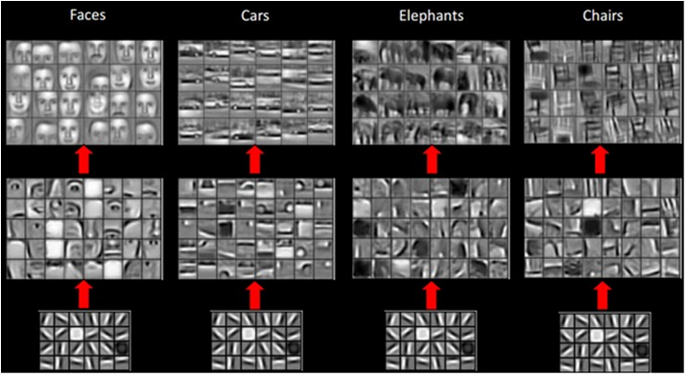
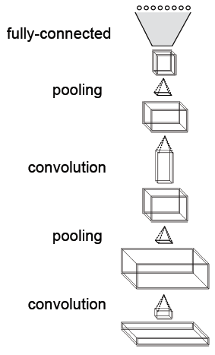
Convolutional Neural Networks
Example

Slide 40
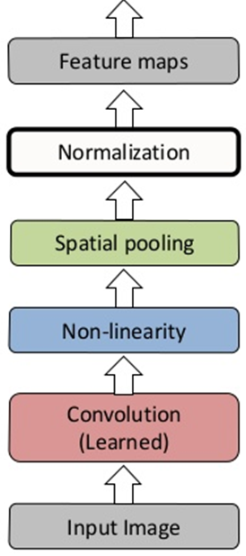
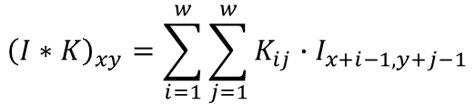


Convolutional Neural Networks
General Structure of CNN
$${f′}_{\frac{x}{2},\frac{y}{2}}=max\left(f_{x,y},f_{x,y+1},f_{x+1,y},f_{x+1, y+1}\right)$$
$$f_{x,y}=S\left({\left(I∗K\right)}_{xy}\right)$$
$${\left(I∗K\right)}_{xy}=\sum_{i=1}^{w}{\sum_{j=1}^{w}{K_{ij}∙I_{x+i−1,y+j−1}}}$$

